Slide 1
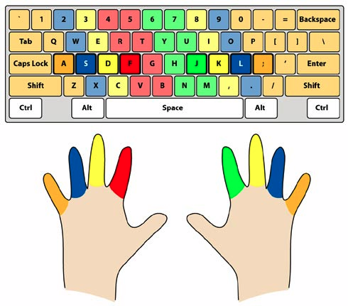
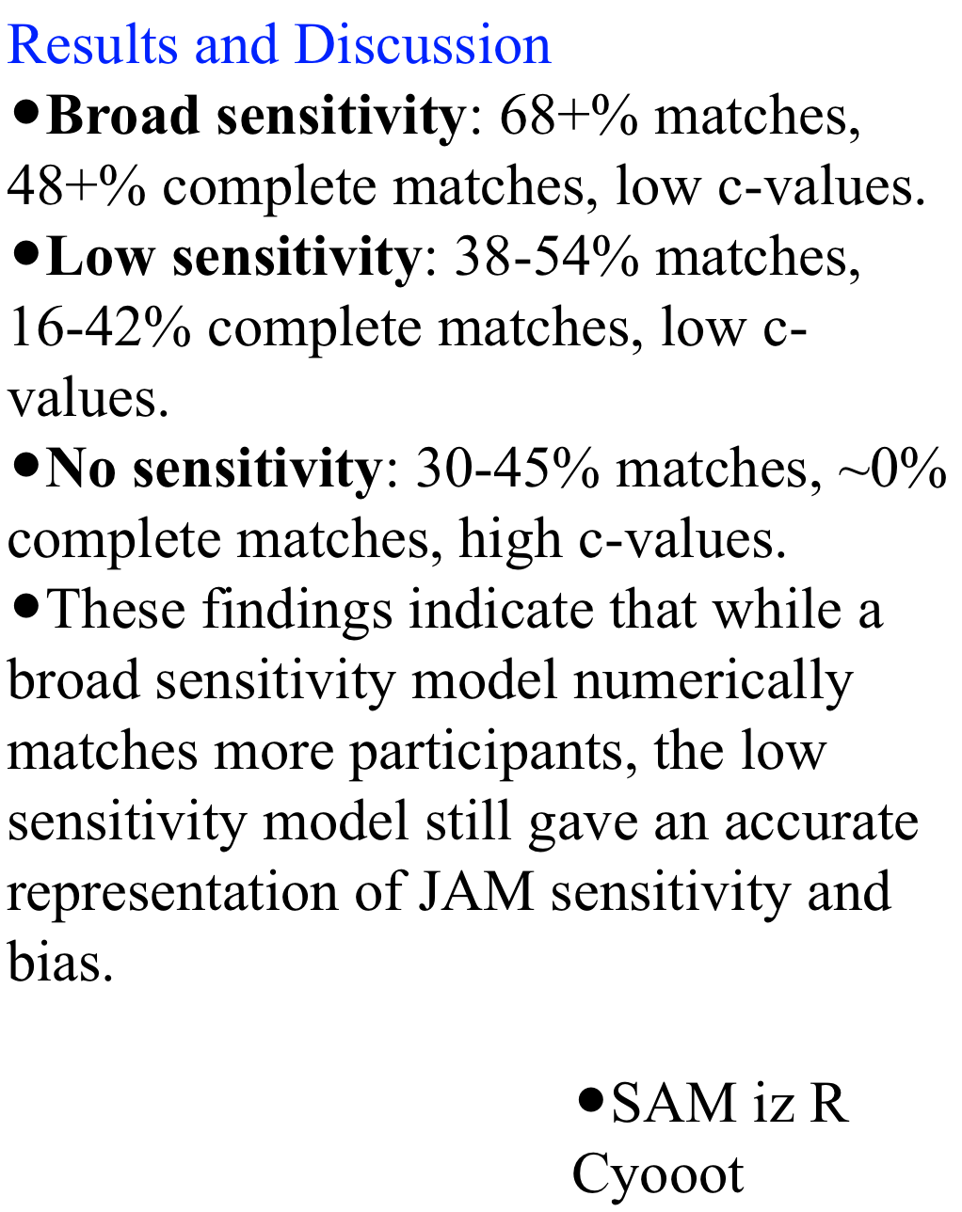
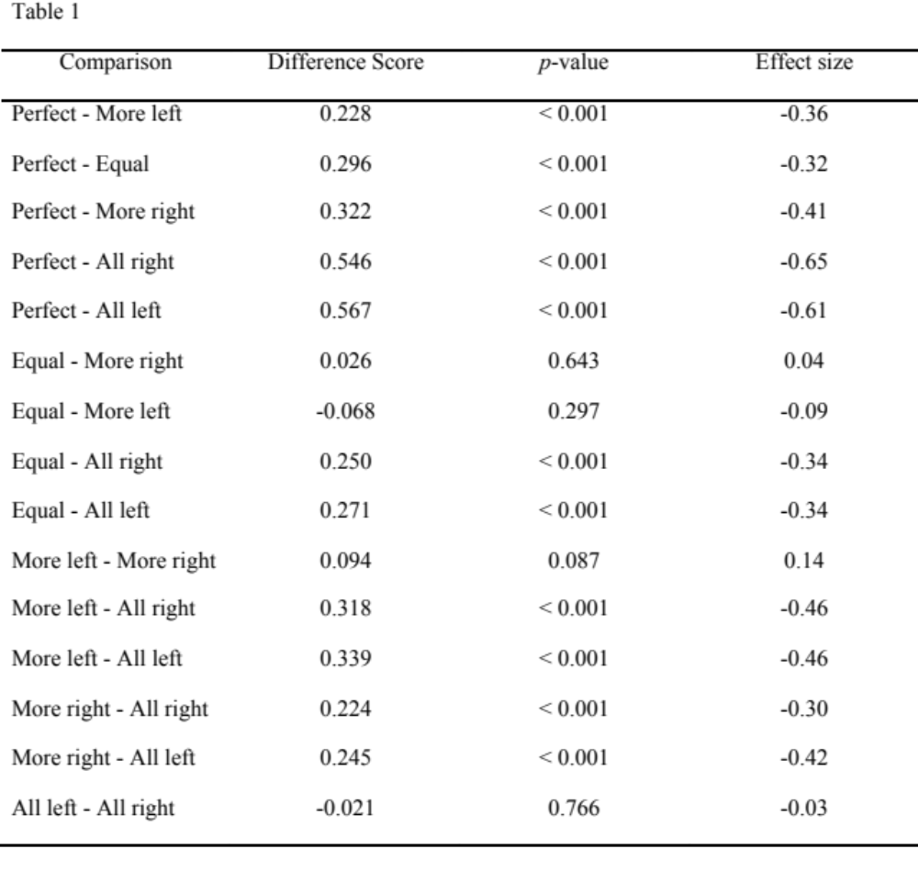
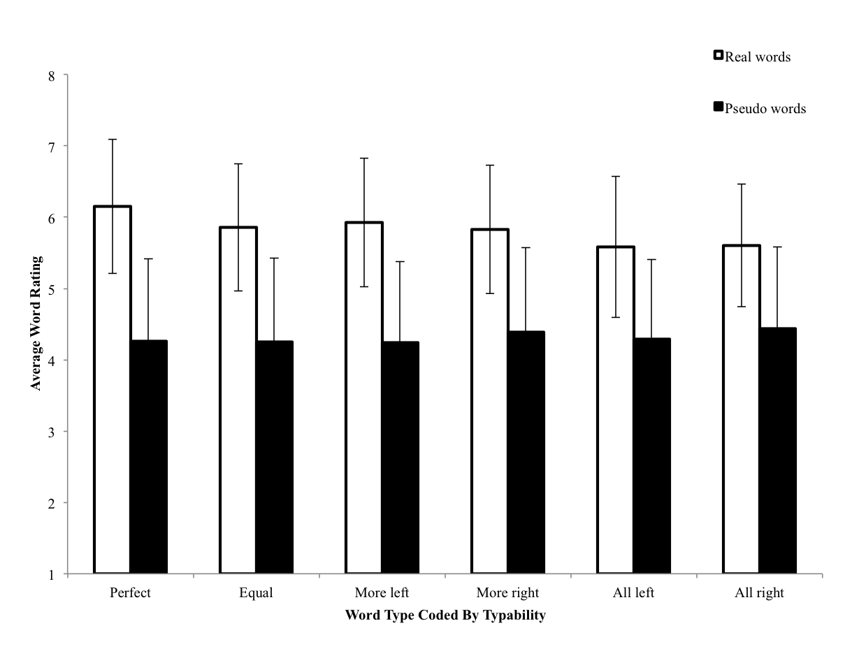
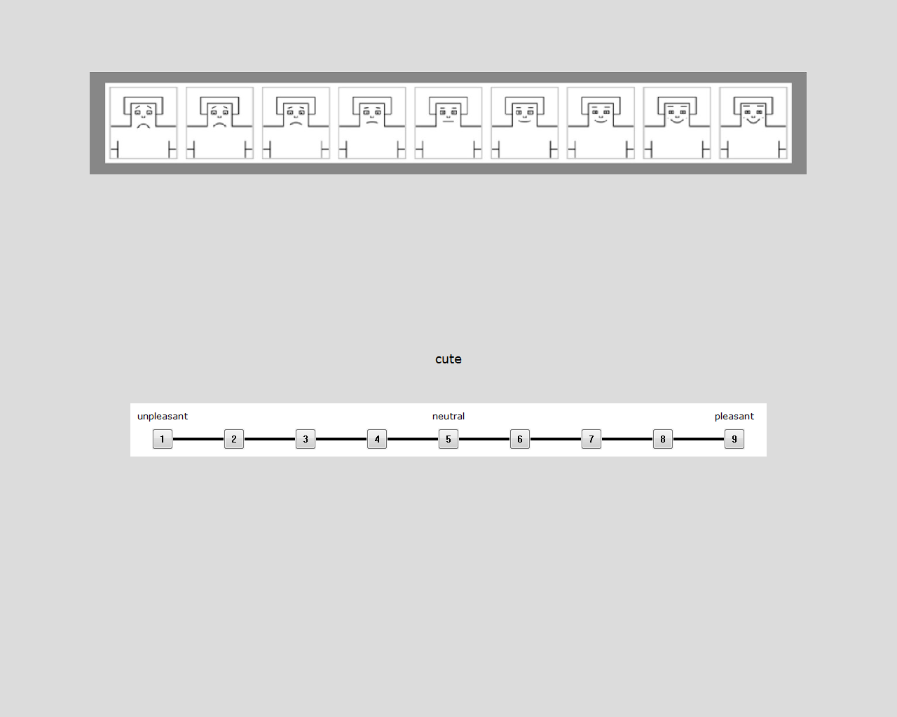
QWERTY: We Like Easy Words To Type
Erin M. Buchanan, Kathrene D. Valentine, Marilee L. Teasley, Missouri State University
Abstract
Recently, Jasmin and Casasanto (2012) published an article about the influence of QWERTY standard keyboards on our perception of words. They argued that the way words are typed has caused people to prefer words that have more right handed typed letters. However, we believe that the analysis of word preference is too simple. Beilock and Holt (2007) have shown that expert typists prefer letter combinations that are on opposite hands over single hands, ostensibly because they are easier to type. This research implies that both skill level and “typability” need to be considered when discussing word preference and typing. The current study replicated Jasmin and Casasanto’s study by examining preference ratings for real and fake words coded for typing sequence and controlling for typing speed of the participant.
Something fun here
Results?
Hypotheses
After controlling for participant typing ability, we expected to find that easier words would be rated higher than more difficult words when considering typability.
  Easy words are key press combinations that alternated hands between letters, which contain less competition for activation in the motor system.
  Therefore, perfectly alternating words should be rated higher than all other word types.
  Secondly, words with at least some alternation (equal, more right, more left: see table below) should be rated higher than words that are typed completely with the left or right hand.
Methods
JAM Slope Calculations.
Unstandardized slopes (B) and intercepts (a) were calculated for each experiment.
All experiments were converted to 100-point scale.
The Nelson et al. norms were used to predict participant ratings in simple linear regression.
B values indicate sensitivity to frequency, where B = 1 would be perfect judgment.
a values indicate estimation bias, where a = 0 would be perfect judgments.
Observation Oriented Modeling.
Observation Oriented Modeling (OOM), a program developed by Dr. James Grice (2011), was used to analyze the data. OOM focuses on observations at an individual level. The modeling program focuses on patterns at the level of a “deep structure” (a way of coding information in which the individual pieces of the structure are called units). These units, in conjunction with observations, create matrices that are used to compare specific predictions, actual data, and randomized data. By comparing the matrices of the expected patterns to the matrices of the specific data, these analyses can be used to determine model fit (using c-values, akin to RMSEA and p-values).
Results
General Discussion
Using a 2 (real/fake) X 6 (all left, all right, more left, more right, equal, perfect) repeated measures ANCOVA with a covariate of typing speed we found significant effects for:
real words being rated higher than pseudo words, F(1, 145) = 103.42, p < .001, η² = .53,
types of words, F(5, 460) =6.25, p < .001, η² = .06.
the interaction between real/pseudo words and word type, F(5, 265) = 12.26, p < .001, η² = .12.
To understand the pattern of interaction, real and pseudo words were analyzed with two different repeated measures ANCOVAs across word type controlling for typing speed. This division shows that:
real words showed significant word type differences, F(5, 460) = 14.27, p < .001, η² = .13, but the pseudo words did not, F(5, 460) = 2.06, p = .07, η² = .02, showing that pseudo words were rated equally regardless of typability.
Next, post hoc analyses were examined using Fisher’s LSD and a Bonferroni correction on real words and word types. See Table 1 for the breakdown of the 15 comparisons of types. Adjusted alpha was set family wise at 0.003.
As shown in the Table 1, perfectly alternating words were rated significantly higher than all other word types left, right or equally split between hands. Next, equally split words, more left, and more right words were rated correspondingly pleasant. Below this group, all left and all right words were rated at similar levels of pleasantness.
ERIN HERE?
References
Grice, J. W. (2011). Observation oriented modeling: analysis of cause in the behavioral sciences. (1 ed.). Academic Press.
Koriat, A., & Bjork, R. (2006). Mending metacognitive illusions: A comparison of mnemonic-based and theory-based procedures. Journal of Experimental Psychology: Learning, Memory, and Cognition, 32(5), 1133-1145. doi:10.1037/0278-7393.32.5.1133
Maki, W. (2007a). Judgments of associative memory. Cognitive Psychology, 54(4), 319-353. doi:10.1016/j.cogpsych.2006.08.002
Maki, W. (2007b). Separating bias and sensitivity in judgments of associative memory. Journal of Experimental Psychology: Learning, Memory, and Cognition, 33(1), 231-237. doi:10.1037/0278-7393.33.1.231
Nelson, D., McEvoy, C., & Schreiber, T. (2004). The University of South Florida free association, rhyme, and word fragment norms. Behavior Research Methods: Instruments & Computers, 36(3), 402-407. doi:10.3758/BF03195588

